Slide 1
Displaying Discrete Numerical Data
Miss L
Year 11 Essentials

Slide 2
From Last Lesson
List 4 ways in which you can display categorical data…
Tally and frequency chart
Column graph
Picture graph
Pie chart

Slide 3
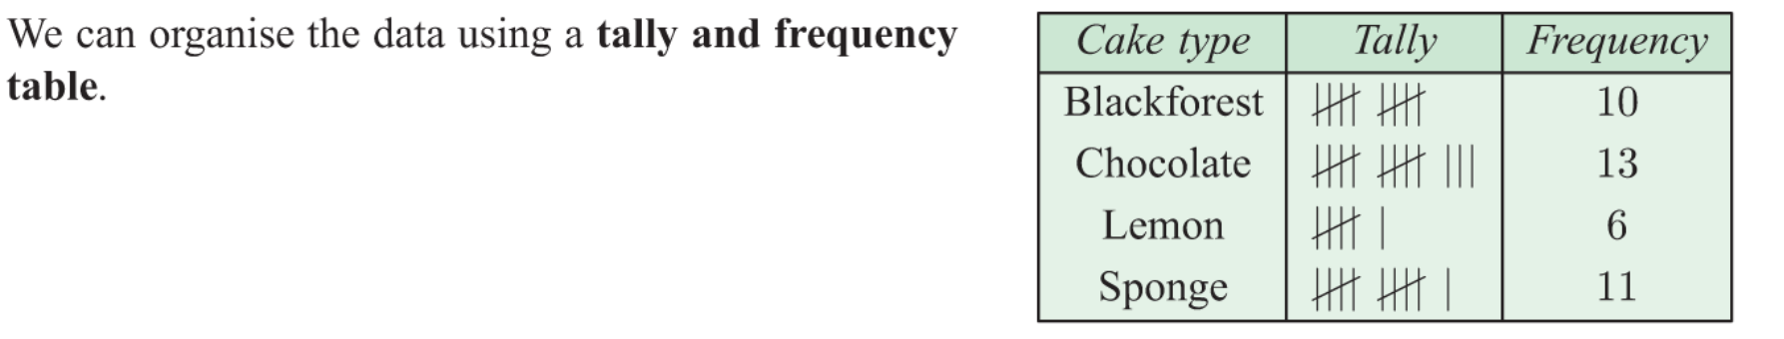
24
7
30
Displaying Discrete Numerical Data
Date
EQ – How can we display discrete numerical data?
What is Discrete Data?
Discrete - Takes exact number values. Usually result of counting

Slide 4
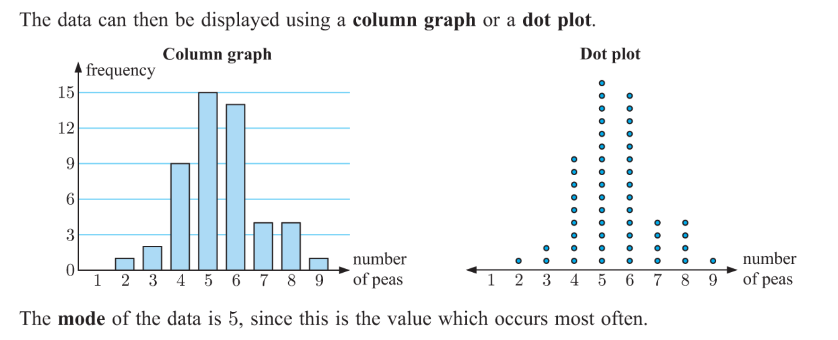
24
7
30
Displaying Discrete Numerical Data
Date
EQ – How can we display discrete numerical data?

Slide 5
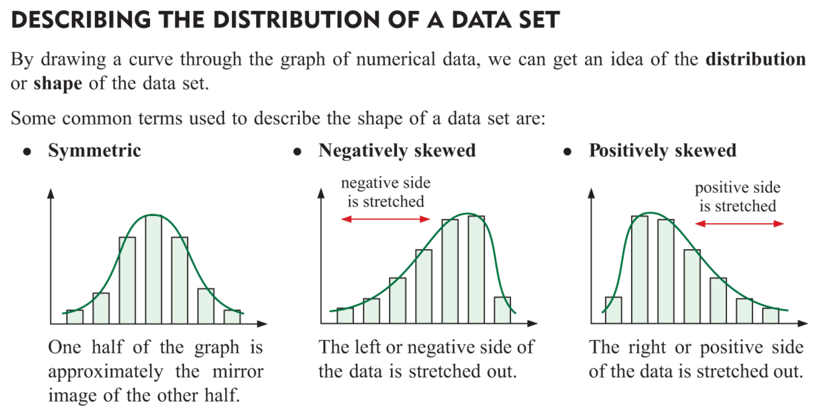
24
7
30
Displaying Discrete Numerical Data
Date
EQ – How can we display discrete numerical data?

Slide 6
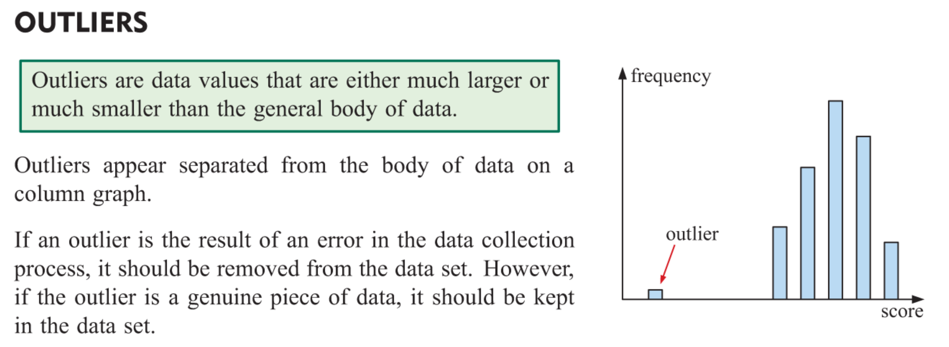
24
7
30
Displaying Discrete Numerical Data
Date
EQ – How can we display discrete numerical data?

Slide 7


Slide 8
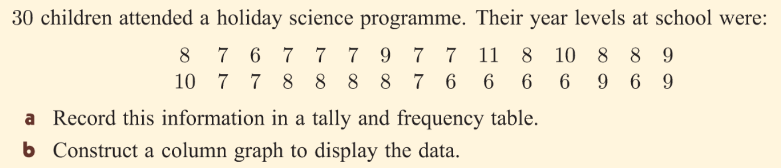
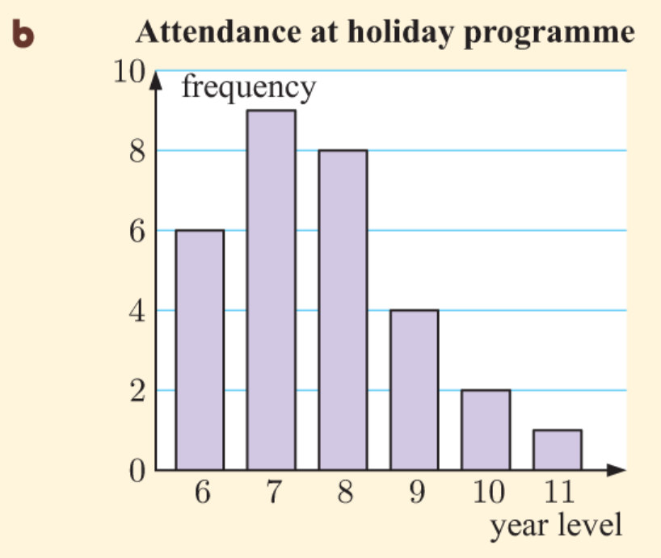
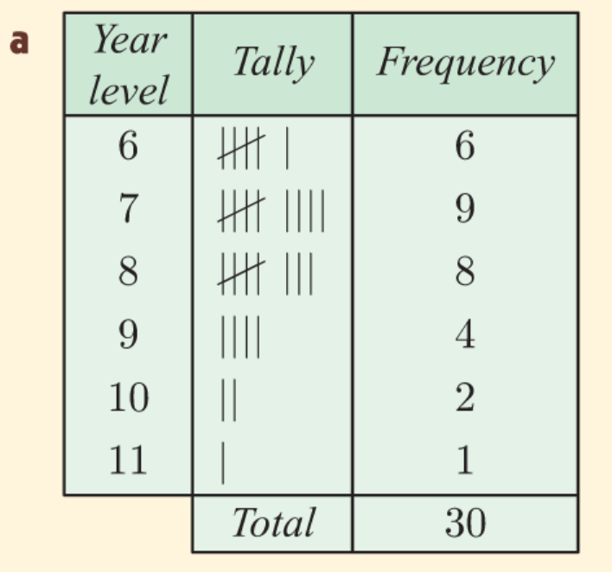
Practice

Slide 9
